Slide 1


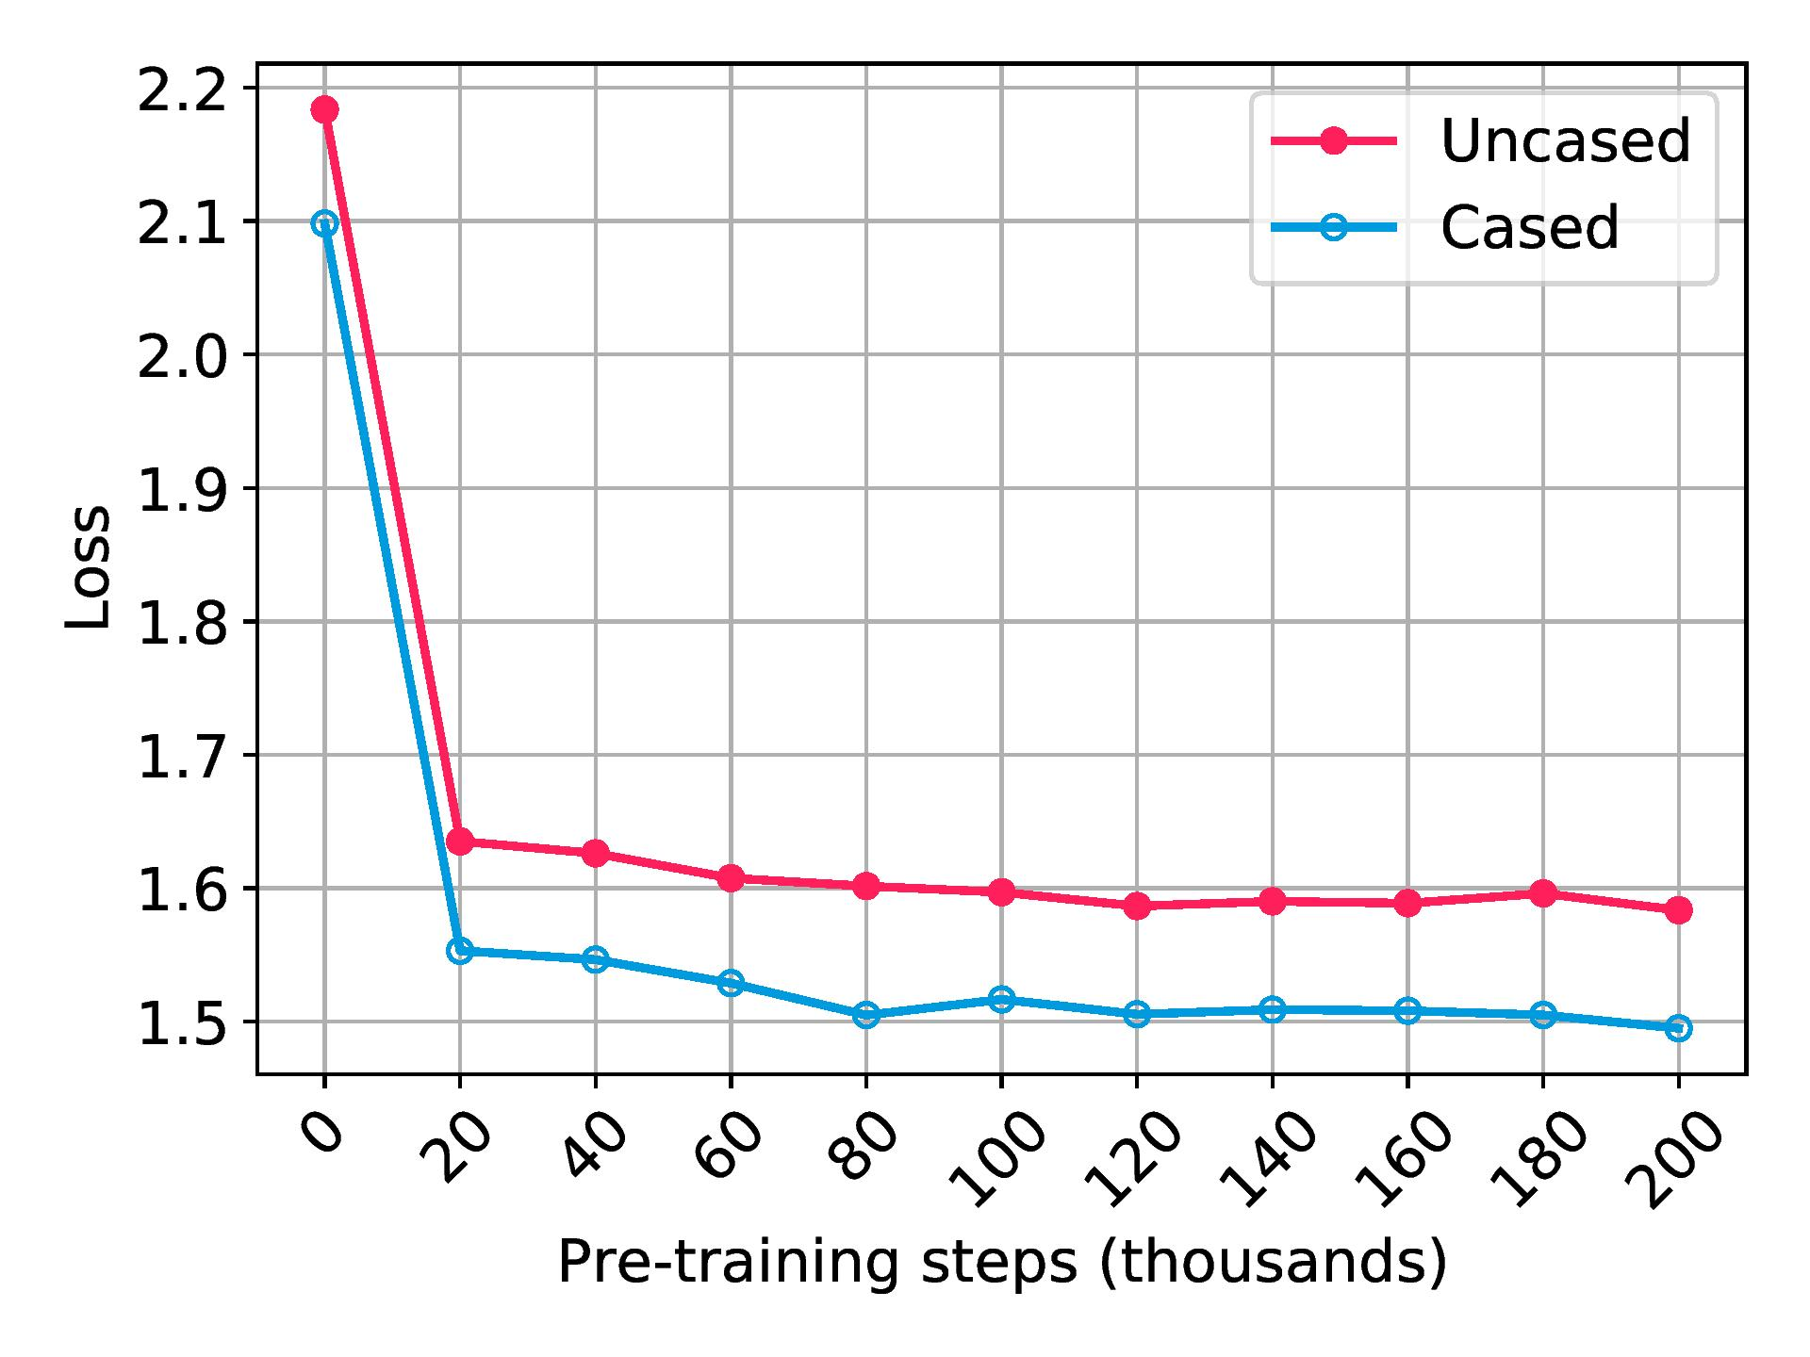
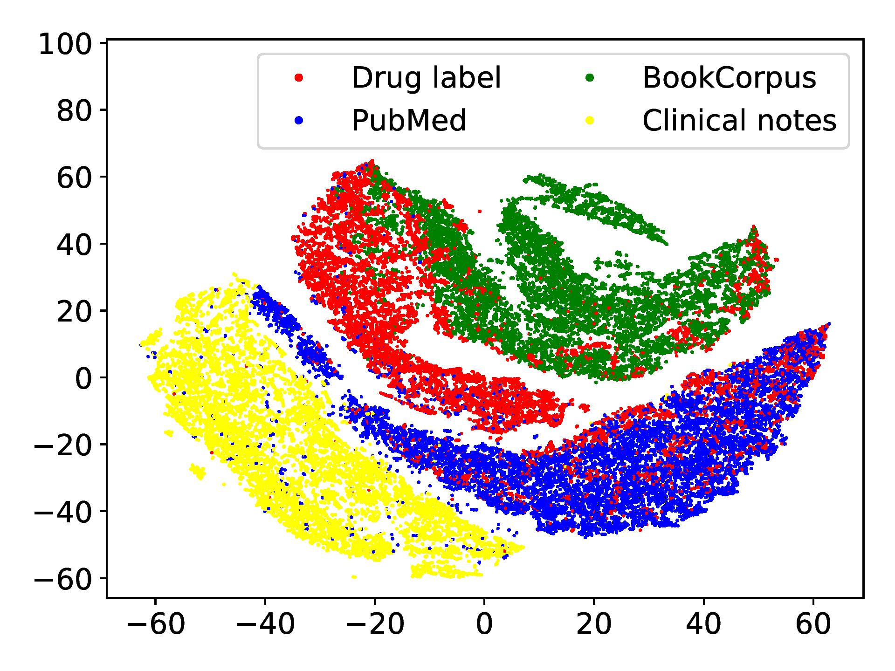
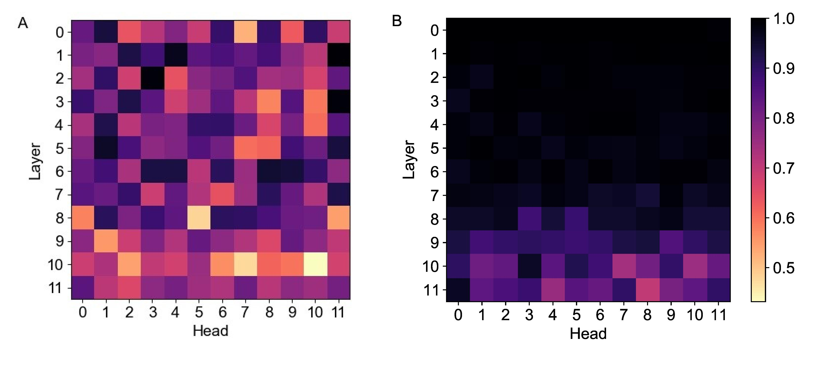
PharmBERT: A domain-specific BERT model for drug labels
Taha ValizadehAslani, Yiwen Shi, Ping Ren, Jing Wang, Yi Zhang, Meng Hu, Liang Zhao, Hualou Liang
Text domains in NLP
Domain-specific pre-training
Testing PharmBERT on drug-label tasks
NLP models are pre-trained on massive text corpora to learn the distribution of the words and then fine-tuned on a down-stream task.
The distribution of the data on the domain of the down-stream task might be different from the pre-training domain.
Further pre-training on the text from the target domain can help the model learn the distribution of the words in the target domain.
PharmBERT was pre-trained using the data of DailyMed.
2 versions of PharmBERT: cased and uncased.
Domain-specific pre-training decreased the loss of the masked language model on drug label text.
ADME classification
The FDA assessor must retrieve drug information of absorption, distribution, metabolism, and excretion (ADME) from the drug labeling for the PSG assessment, manually.
We automated this process by fine-tuning the models for classifying pharmacokinetic text paragraphs into 5 topics, namely, absorption, distribution, metabolism, excretion (ADME) and other, based on their semantic meaning.
Model | Mean F1 (Std Dev)
BERT-uncased | 0.9025 (0.0029)
PharmBERT-uncased | 0.9132 (0.0026)
BERT-cased | 0.9021 (0.0033)
PharmBERT-cased | 0.9165 (0.0036)
BioBERT | 0.9116 (0.0019)
Drug labels are the printed information, such as drug description, warnings and precautions, etc., included in the box of any medicine. We further pre-trained BERT on drug labels.
Text samples of different domains cluster together in the embedding representations of BERT.
We visualized the embeddings of the general BERT for text samples from different domains, namely, drug labels, general English (BookCorpus), clinical notes, and PubMed abstracts, using t-SNE.
Adverse reaction detection
The Center for Drug Evaluation and Research (CDER) in FDA is interested in detecting the adverse reactions of the drugs from drug labels automatically.
The first task in 2017 Text Analysis Conference (TAC) was to extract adverse reactions and their related mentions from the drug labels.
We fine-tuned the models for this classification task, where the goal is to assign each word to either an adverse reaction, a mention (severity, factor, drug class, negation, animal) or declare is as an ordinary word.
How does the model change?
Does the model change more during the domain-specific pre-training or during the fine-tuning? We compared the cosine similarity of attention heads.
We compared pre-trained BERT vs. pre-trained PharmBERT (A) and pre-trained PharmBERT vs. fine-tuned PharmBERT (B).
Model | Mean F1 (Std Dev)
BERT-uncased | 0.8769 (0.0016)
PharmBERT-uncased | 0.8923 (0.0012)
BERT-cased | 0.8700 (0.0017)
PharmBERT-cased | 0.8845 (0.0007)
BioBERT | 0.8897 (0.0009)
Notes:
You can add your presentation notes here. This presentation template for research posters is fully editable so text, graphics and content can be updated to fit your own research needs.
Download more poster presentation templates from FPPT.com

